Slide 1
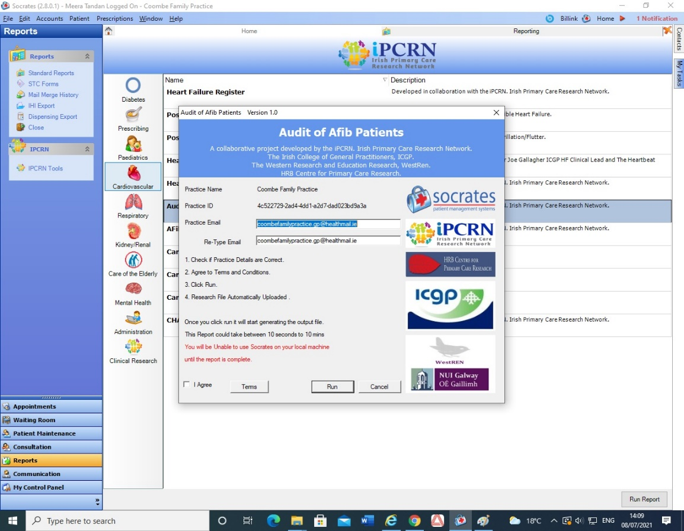
Guidelines to extract “IPCRN reports” from Socrates. (Please follow the step by step instructions)
STEP 1- Log in Socrates
The following window pops-up
STEP 2- Click “Reports”
STEP 3– Click “IPCRN Tools” It shows you the list of IPCRN tools on the right side of the screen.
For Heart Failure(HF) and Afib reports
Click “Cardiovascular”
STEP 4
B. For Diabetes report
Click “Diabetes”
Click “Audit of Diabetes Care”
and proceed to step 5
For HF report,
Click “heart failure Audit” and proceed to step 5
For AFib report,
Click “Audit of AFib” and proceed to step 5
This window pops-up for HF, Afib and diabetes respectively
STEP 5 - Fill in the information
Type your practice name
Note: Please ensure that you use a valid email address. Otherwise you will not receive the reports.
Your Practice ID will be generated automatically.
Type Practice valid email ID
Re-type practice valid email ID
STEP 6- Tick “I Agree”
STEP 7- Click “Run”
IPCRN will generate your practice report and send it to you on the practice email ID you submitted. Generally, you will receive your report in 3 to 4 hours but sometimes it may take a day.
STEP 8: File Download : Download the three reports from your email to your computer.
Note: If you open the files, you will see randomly generated unique practice ID. You may delete this ID if you choose. We will not be able to identify your practice based on this ID unless you or IPCRN inform us.
STEP 9: Attaching and Sending Files: Email all the three files as an attachment to meera.tandan@ucd.ie. You will get an acknowledgement email once it is received.
You are all done!
Thank you!! 👍

